Slide 1
Monolithic 3D Integration
RC delay of vertically integrated circuits
Top-tier TFT circuit
Literature review & revised presentation
MAC inter-tier dielectric
Bottom-tier TFT circuit
Research question:
When is tM3D < t2D?
Project 8 · MLE5003 · NUS

Slide 2
Presentation structure
A map for listeners with no background
1. Motivation
2. Device & link
3. Measurement
4. Decision
Why interconnect RC delay matters; 2D vs M3D.
What driver / receiver / MIV mean; where R and C come from.
How to measure inverter delay, 1T1R link R/C and ring oscillator frequency.
Use matched 2D and M3D controls + SPICE to test tM3D < t2D.
Slide 12
Slides 3–4
Slides 5–7
Slides 8–11
Main story: shorter wires are useful only if added vertical parasitics stay small.
Supervisor feedback addressed: outline, terminology, visual schematics, DOI links, and slide numbers.
2

Slide 3
Key terms before the physics
These definitions prevent confusion later
MIV
inter-tier via
t2D = delay of planar reference
previous stage
next stage
tM3D = delay of stacked circuit
Driver
sends signal
Vertical link
short 3D connection
Receiver
receives signal/load
Pdyn ∝ α C VDD² f
MIV = Monolithic Inter-tier Via
(vertical electrical connection between tiers)
Driver/receiver are roles, not special device names. A whole inverter can be a driver stage; another inverter can be the receiver stage.
Pdyn: dynamic switching power. α: switching activity. VDD: supply voltage. f: operating frequency.
3

Slide 4
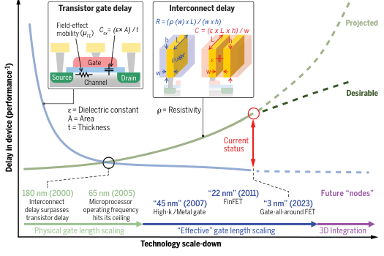
Why M3D? Interconnect delay is the bottleneck
The physics is just R + C + charging time
2D routing: long intra-tier wire
Driver A
long wire → R and C
Receiver B
M3D routing: short vertical link
Top tier
R = ρL / A
MIV
Bottom tier
C ≈ ε₀kA / d
M3D wins only if
benefit of shorter interconnects > penalty from vertical parasitics
Reference: Kim et al., Science 386, eadk6189 (2024). DOI: https://doi.org/10.1126/science.adk6189
4

Slide 5
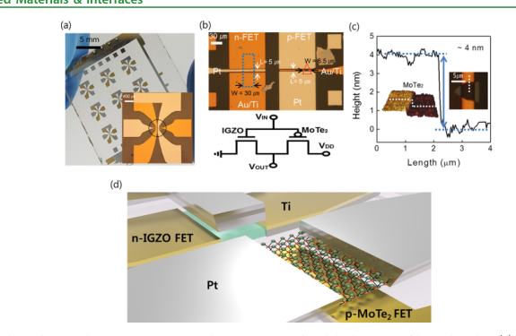
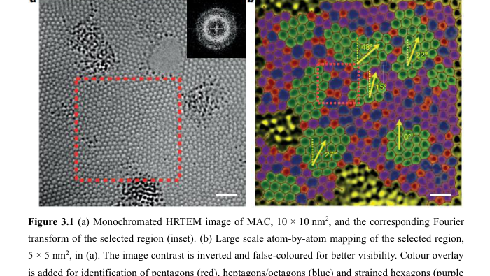
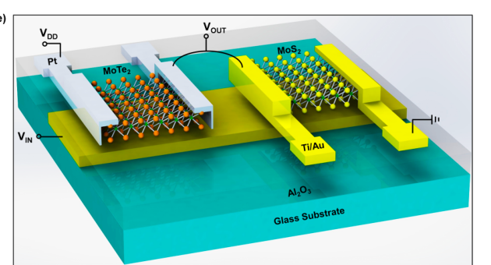
What can a vertically integrated circuit look like?
Use real device schematics to build intuition
MoTe₂ / MoS₂ inverter
2D-material CMOS example
MAC: disordered carbon network
candidate inter-tier dielectric
MoTe₂ / IGZO hybrid CMOS
2D + oxide TFT example
Project target: stacked TFTs + MAC inter-tier dielectric + measured vertical-circuit delay
Device examples: Pezeshki et al., ACS Nano 10 (2016). DOI: https://doi.org/10.1021/acsnano.5b06419 · Lee et al., ACS AMI 9 (2017). DOI: https://doi.org/10.1021/acsami.7b02838 · Deng Chi thesis / MAC section.
5

Slide 6
T/R structures: count the signal source and the load
They are signal-transmission test structures, not memory cells
1T0R
0T1R
1T1R
1T2R
2T1R
driver only
receiver only
point-to-point
fan-out = 2
shared receiver
Transmitter
finite Rdrv
Vertical link
Rint + Cint
Receiver
input capacitance Cin
Role: transmit a voltage transition and measure how the link loads/slows the signal.
More receivers → Cload ↑ → delay ↑
T = transmitter / driver; R = receiver / load. Exact layout must follow the group’s mask design.
6

Slide 7
Where exactly do R and C come from?
Mark them on a stacked cross-section and then build a π-RC model
Top TFT / receiver gate
Lumped π-RC starting model
top metal / gate / contact
Coverlap / Cfringe
MAC / ILD
Cinter-tier
Rdrv
Rint
bottom metal / drain node
Rcontact / Rvia
Bottom TFT / driver
Cout + Cint/2
Cint/2 + CL
τE = Rdrv(Cout + Cint + CL) + Rint(Cint/2 + CL)
C ≈ ε₀ k Aoverlap / d | R wire = ρL/A = Rs L/W
π-RC is a first model. Real delay is taken from transient waveform. Aoverlap is conductor overlap area for C.
7

Slide 8
Inverter: the basic logic test circuit
What it does, what it needs, and what graphs it gives
VDD
Logic function: Y = NOT(A)
Standard CMOS inverter
= p-FET + n-FET
Resistor-loaded inverter
= 1 transistor + R
(possible, less ideal)
p-FET
VIN
VOUT
VIN = 0 → VOUT ≈ VDD
VIN = VDD → VOUT ≈ 0
n-FET
Transistor + capacitor
= dynamic/load element
not a static inverter alone
GND
Main measured graphs
TFT: ID–VG and ID–VD
device performance
Transient: VIN(t), VOUT(t)
switching speed
Inverter VTC: VOUT–VIN
logic function
Drive strength: t ≈ Cload · VDD / Ieff
Pezeshki (2016) and Lee (2017) use TFT inverters to connect transfer curves, VTC and dynamic switching.
8

Slide 9
How to measure propagation delay and edge time
Put the definitions directly on VIN/VOUT waveforms
VIN
tpHL = 50% VIN ↑ → 50% VOUT ↓
tpLH = 50% VIN ↓ → 50% VOUT ↑
50%
tp = ½(tpHL + tpLH)
VOUT
single-pole RC: τ = RC, t50 ≈ 0.69RC
tr / tf (10–90%)
tpHL
10–90% edge: tr, tf ≈ 2.2RC
Also check signal integrity: voltage swing, crosstalk, noise, droop and waveform distortion.
Definitions assume ideal step response for intuition; actual delays are extracted from measured transient waveforms.
9

Slide 10
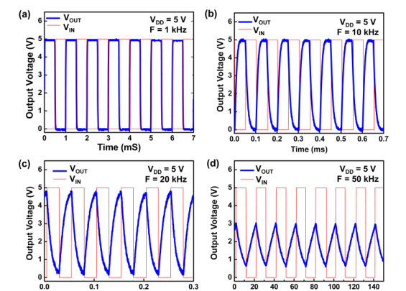
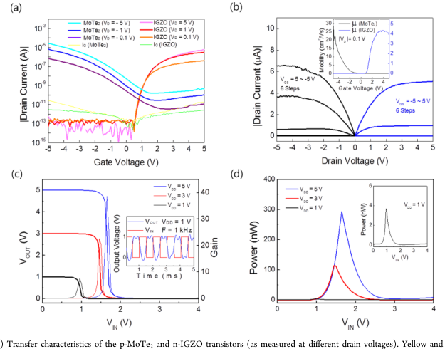
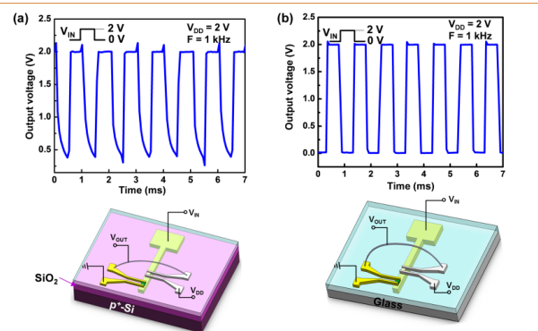
Literature evidence: real devices show parasitic-limited speed
Use actual device figures and label what is different
Same 2 V / 1 kHz comparison
(a) SiO₂/p⁺-Si: large overlap → ~480 μs
(b) glass: lower overlap → much faster
MoTe₂/MoS₂ inverter
reported ~25 μs at 5 V, 20 kHz
MoTe₂/IGZO hybrid CMOS
reported ~200 μs at 1 V, 1 kHz
contact R + overlap C
Important: different devices and biases → not a speed ranking; use them to learn what to measure.
Pezeshki et al., ACS Nano 10, 1118–1125 (2016). DOI: https://doi.org/10.1021/acsnano.5b06419 · Lee et al., ACS AMI 9, 15592–15598 (2017). DOI: https://doi.org/10.1021/acsami.7b02838
10

Slide 11
Proposed 1T1R test vehicle: measure R, C and delay independently
A clean bridge between single TFTs and full inverter/ring-oscillator circuits
Inverter / TFT driver
vertical link
MIV + MAC
one receiver gate
known Cin
matched planar reference
R measurement
C measurement
Delay measurement
Controls
force I
sense V
top electrode
scope CH1: VIN(t)
scope CH2: VOUT(t)
extract tp, tr, tf, swing
same VDD
same fan-out
same probe load
same temperature
de-embed pads
MAC / ILD
bottom electrode
R = V/I
C(f,V) by impedance / C–V
R: force current and sense voltage. C: capacitor / impedance structure with open/short controls. Delay: pulse generator + two oscilloscope channels.
11

Slide 12
Ring oscillator + SPICE: the circuit-level closure
Average many stages, then explain the result with extracted R/C
SPICE example
Pulse VIN
TFT inverter
Rint
INV1
INV2
INV3
Cint + CL
Measured TFTs + extracted RC
→ simulated VIN/VOUT
→ matched 2D vs M3D
Odd number of inverters:
N = 3, 5, 7, …
tp,stage ≈ 1 / (2Nfosc)
For 3 CMOS stages:
3 inverters × 2 TFTs = 6 TFTs
plus vertical links if stacked
M3D wins when wire savings exceed added parasitic delay.
Core question: When does tM3D < t2D in our stacked TFT platform?
Ring oscillator reference: Xie et al., Nano Research 12, 1810–1816 (2019). DOI: https://doi.org/10.1007/s12274-019-2436-2 · SPICE compares calibrated device models + extracted parasitics.
12

